Slide 1
Do Our Experiences Cause Our Fears and Phobias?
By Ava, Ella & Matthew

Slide 2
Why did we pick this topic?
We brainstormed ideas
We continued to narrow down ideas until we were left with the topic that interested us the most!

Slide 3
How Did We Carry Out This Project?
We created a survey
We gave the survey to students and teachers, as well as some family members
We collected the completed surveys, looked at, and recorded the results
We researched the project using the Internet
Finally, we put our survey results and research into this presentation to attempt to answer the question:
Do Our Experiences Cause Our Fears And Phobias?

Slide 4
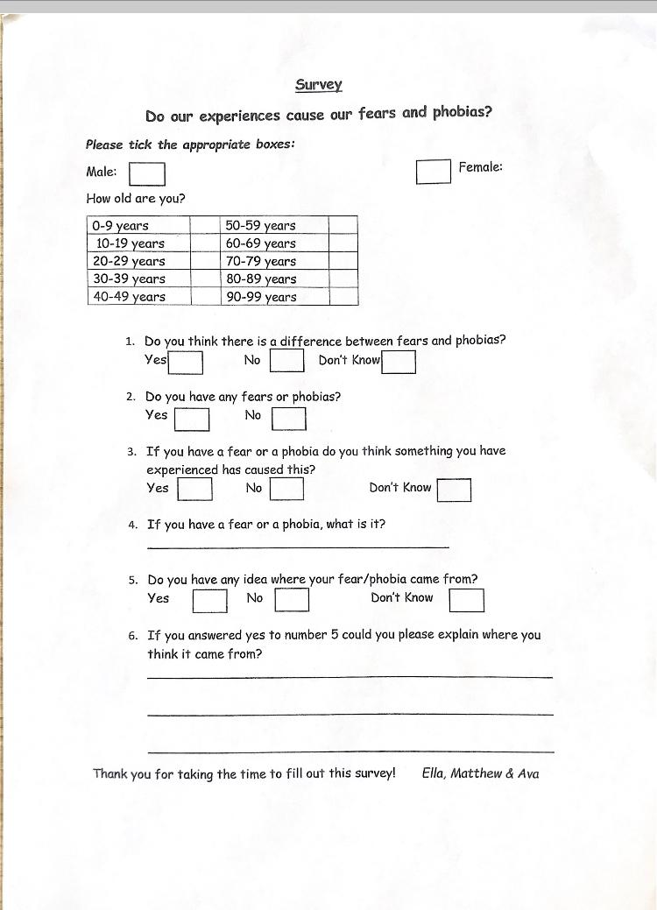
Here Is Our Survey

Slide 5
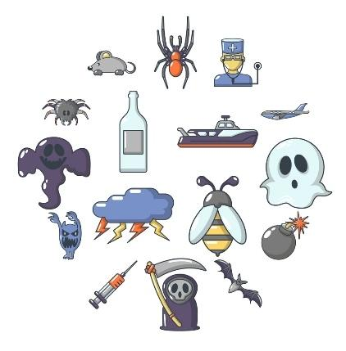
Results Of Survey
Out of 109 people surveyed 88 reported that they had a fear or phobia!

Slide 6
What are Fears and Phobias?
A fear is a normal reaction to a threat, whereas a phobia is an irrational fear response even when you are not in danger.

Slide 7
What Fears or Phobias Did People Report Having?
Dying
Falling
Darkness
Flying
Tight spaces
Horses
Ghosts
Rats
Lifts
Escalators
Getting Lost
Vacuum Cleaners
Needles
Mice
Snakes
People Chewing
Clowns
Drowning
Insects
Losing Family
Dogs
Bees

Slide 8
Results From Survey
50 % of the people we surveyed believed that their fear or phobia came from an experience(s) that they had!
Most of the people believed that this fear came from an experience in their childhood or adolescence.

Slide 9
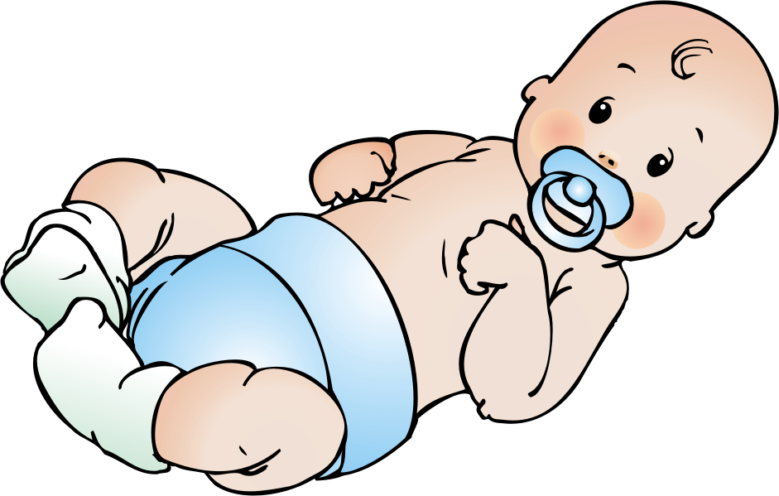
Are We Born With Any Fears or Phobias?
After some research we found out that we are born with two innate fears:
Falling & Loud Noises

Slide 10
So, Is It Our Experiences That Cause our Fears and phobias?
According to research, by the MAYO Clinic in 2016, many phobias develop as a result of negative experiences related to a specific object or situation. They also stated that genetics and environment play a part in developing fears and phobias.
Villafuerte and Burmeister from the Mental Health Research Institute in Watson , Michigan also stated that genetics may have a role to play in why some people develop fears and phobias.
They found that first-degree relatives of someone suffering from a phobia are 3 times more likely to develop a phobia. They also found that if a twin suffers from a specific phobia the second twin has a 30% chance of developing a specific phobia compared to the 10% chance of someone in the general population developing one.

Slide 11
Little Albert Experiment
In 1920 J.B. Watson, a pioneering psychologist, carried out the ‘Little Albert Experiment’
Albert was a 9 month old baby who was conditioned to develop a fear of rats. Before the experiment he played happily with the rats.
However, after the experiment, he developed a fear of rats and other furry things after the researchers banged a hammer against a steel pole everytime he went to touch the rat.
He was conditioned to become afraid of the rat and other furry items including Santa Claus’ beard!!
This is an experiment we DO NOT AGREE WITH!

Slide 12
Conclusion
As we are born with only two innate fears we have come to the conclusion that our experiences do cause our fears or phobias.
We have learned, however, that genetics may also play an important part in why somebody may develop a fear or phobia.

Slide 13
Thank you Dr. Katie Ryan!
We hope you enjoyed our presentation!

