Slide 1
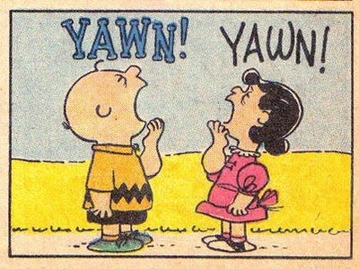
Are yawns contagious, And if so, why? By, Ryan, Cormac, Oisin D, Oisin G, Matthew, Lily, Harry & Ruth

Slide 2
How Did we come up with this idea?
We brainstormed lots of ideas
We narrowed down our ideas by discussing the different topics
We decided to choose this topic because it is something we wanted to learn more about

Slide 3
What did we do first?
We created a survey to ask students in our school if they thought yawns were contagious
We surveyed students from 3rd to 6th class.
We collected the surveys and we looked at the results.

Slide 4
This is a sample of our survey
Survey
Are Yawns Contagious, and if so, Why?
Please tick the correct box:
1.Do you think yawns are contagious?
Yes No Not Sure
2. Do you usually yawn when other people yawn?
Yes No Not Sure
3. If you think yawns are contagious, please write down why you think this is? ________________________________________________ ________________________________________________ _________________________________________________
I do not know
Thank you for filling out our survey! Matthew, Cormac, Lily, Ryan, Oisin G, Harry, Ruth, Oisin D

Slide 5
Survey results 66 students returned surveys

Slide 6
56% of people surveyed said that they yawn when other people yawn!

Slide 7
What are some of the reasons people think yawns are contagious?
Our brain thinks we should do what other people do
If you see somebody yawn you feel tired so you yawn
It is a primal instinct to yawn
It is human nature to copy others

Slide 8
So why do we yawn?
When we are tired we stop taking deep breaths which causes a build up of carbon dioxide in our bodies, therefore We yawn so that we can get more oxygen into our lungs!

Slide 9
Types of yawning
Through our research we found out that There are two types of yawns; a yawn that occurs on it’s own , which is called ‘spontaneous yawning’ and a yawn that occurs after seeing someone else yawn which is called ‘contagious yawning’.

Slide 10
Mythbusters
In an episode of the TV show called ‘mythbusters’ they tested 50 people to see if yawning is contagious.
They recruited 50 people under the pretense that they were looking for people to appear on the show. The recruiter spoke to each subject one-on-one and intentionally either yawned or did not yawn during the session.
Those that were influenced into yawning, yawned 29% of the time and those that were not influenced into yawning yawned 25% of the time.
The Mythbusters team felt that this 4% difference was not considered big enough of a difference to draw a definite conclusion that yawning is contagious.

Slide 11
So, Are yawns contagious?
Dr. James Giordano a professor in the department of Medicine and Neuroscience in Georgetown University stated that yawning is contagious and this May be due to a phenomenon called ‘social mirroring’ where we imitate the actions of others.
He stated however, that more research is needed in this area.

Slide 12
Yawning Study
The university of Nottingham carried out a study called ‘A neural basis for contagious yawning’
They found that our ability to resist yawning when someone near us yawns, is limited.
this is considered an echophenomena; an automatic imitation of someone’s actions (echopraxia)

Slide 13
Conclusion
After our research We believe yawns are contagious but we think there needs to be more study in this area to know for sure!

Slide 14
Thank you Dr. Anne Moore We hope we didn’t make you yawn!

