Slide 1
Do Our Experiences During The Day Affect What We Dream of That Night?
By
Róisín, Meera, Shóna, Iris,
Joe, Emmet and Matthew

Slide 2
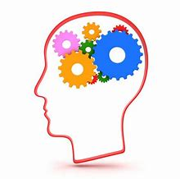
How We Got To Our Question
First we brainstormed to come up with ideas for the project.
After lots of discussion we narrowed it down until we came up with our topic.
We felt that dreams would be a very interesting subject to research.

Slide 3
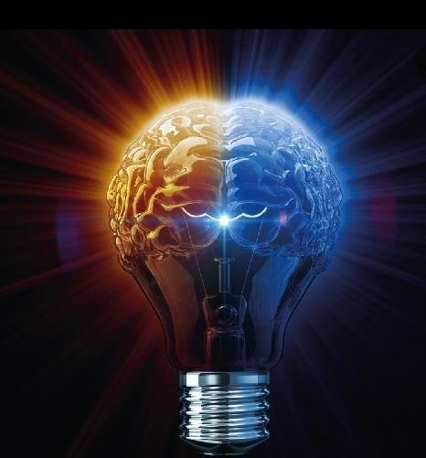
How We Carried Out This Project
We came up with our idea.
We then created a survey to ask people’s opinions on whether or not they thought that daily experiences affect our dreams.
After people had returned the survey we looked at the data
After that we created a questionnaire to see if people’s experiences did in fact affect their dreams , this was a 14 day study with 21 people.
We also researched the topic online.

Slide 4
Do Our Experiences During The Day Affect d What We Dream of That night
Please tick the appropriate box
I am
Male Female
1 Do you Dream? Yes No Not sure
2 If you do Dream please state now often you dream
Frequently Sometimes Rarely Not Sure
3 Do you think what happens to you that day affects your dreams that night
Yes No Not Sure
4 Are you a light or deep sleeper
Light Deep Not Sure
Here Is An Example Of The Survey We Conducted.

Slide 5
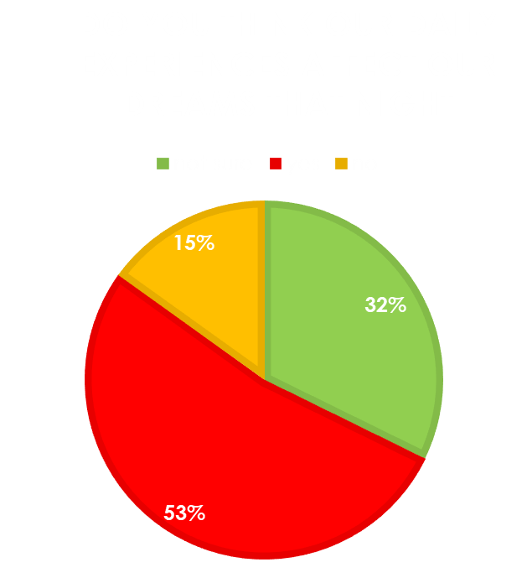
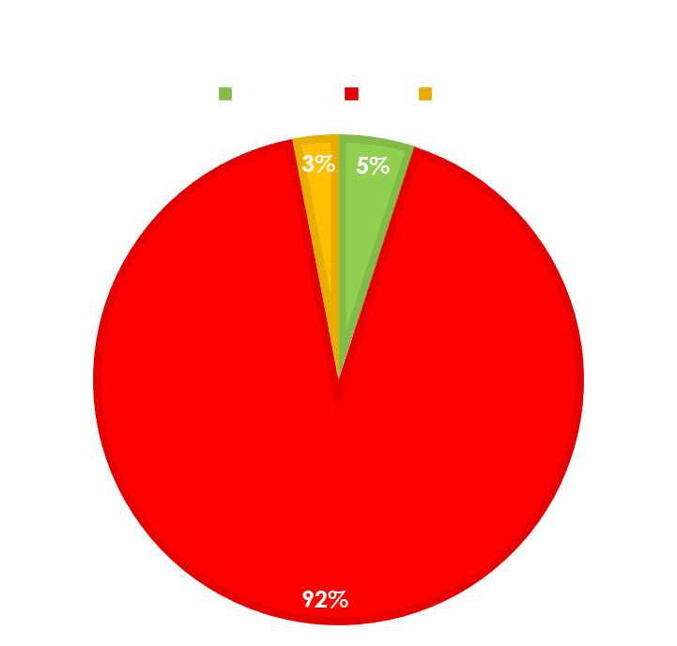
This Is The Result Of Our Survey
74 people returned surveys.

Slide 6
Sleep study
Please fill in this form every morning | Did you dream? | Did your dreams relate to anything you did yesterday?
Saturday 19th
Sunday 20th
Monday 21st
Tuesday 22nd
Wednesday 23rd
Thursday 24th
Friday 25th
Saturday 26th
Sunday 27th
Monday 28th
Tuesday 1st
Wednesday 2nd
Thursday 3rd
Friday 4th
Here Is An Example Of The Sleep Study That We Conducted

Slide 7
Results of Our Sleep Study
Did Your Dream Relate to Anything You Did Yesterday?
There was a 14% difference in the people who reported that more than half of their dreams were affected by their daily experiences than those whose dreams were affected less than half the time.

Slide 8
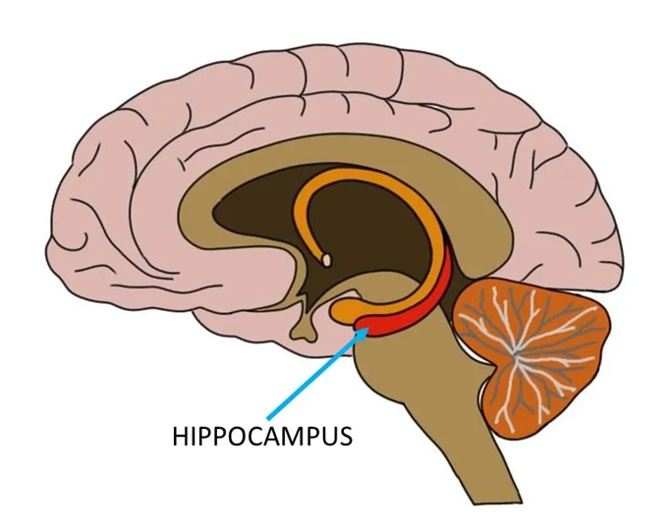
What Part of Our Brain is Used to Dream?
The main part of the brain that we use when we dream is the hippocampus.
The hippocampus has a central role in our ability to remember, imagine and dream.

Slide 9
Dreaming
It is thought that through the night everybody dreams, we just don’t all remember them.
These dreams happen in phases.
They go from the most realistic, to the most unrealistic.
Most Realistic Most Unrealistic

Slide 10
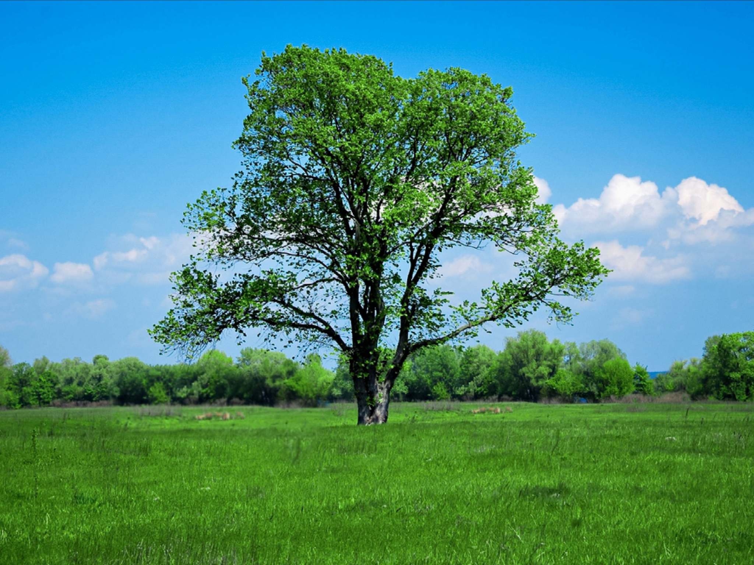
Phases of Dreams
You go through these phases because your brain sorts through the information it was given during the day.
Your brain then deletes all the information that it thinks is unimportant.
In the end your dreams can become extremely unrealistic.
You only usually remember your last dream of the night.
This could turn into
that
by the end of the night!

Slide 11
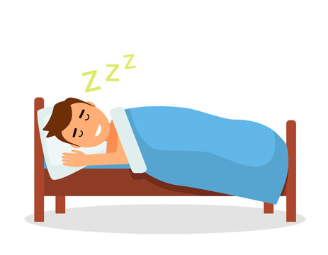
Do Dreams Mean Anything?
The activation-synthesis hypothesis was proposed by psychiatrists John Allan Hobson and Robert McCarley from Harvard University in 1977. This theory states that dreams don't actually mean anything. Instead they're merely electrical brain impulses that pull random thoughts and imagery from our memories.
The theory suggests that humans construct dream stories after they wake up. This is a natural attempt to make sense of it all.

Slide 12
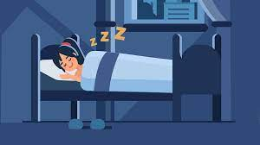
Results
92% of people surveyed reported to dream.
Males reported to dream more than females
53% of people surveyed felt that your daily experiences affect your dreams
Our Sleep Study found that 57% of people reported their dreams were in fact affected by what they had experienced during the day over 50% of the time
43% of people reported that it was less than 50% of the time that their dreams were affected by their experiences.
The Activation-Synthesis Theory states that our brain pulls random memories, thoughts and images from our brain though it does not specify when those memories, images and thoughts were experienced by the dreamer.

Slide 13
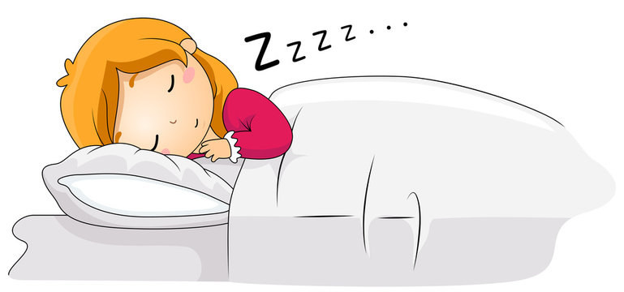
Conclusion
AFTER OUR SURVEY, SLEEP STUDY AND RESEACRH WE BELIEVE THAT OUR DREAMS ARE AFFECTED BY OUR EXPERIENCES BUT PERHAPS NOT NECESSARILY BY OUR DAILY EXPERIENCES.
WE ALSO FEEL THAT THIS DOES NOT SEEM TRUE FOR EVERYONE AND MORE STUDY IS PROBABLY NEEDED IN THIS AREA.

Slide 14
Thank you for listening Lyndsey Moore!

