Slide 1
Are there different types of intelligence?
By Zarah, Ewan & Emetas
3rd Class

Slide 2
How did We decide on This Project?
We brainstormed many ideas!
We decided on this topic because we were the most interested in it and we felt it would be a good one to research

Slide 3
How did we carry out this project?
We created a survey to gather information from children in 3rd to 6th class and teachers in our school. We wanted to see if they thought there was more than one type of intelligence.
For those who thought there were more than one type we asked them to name those intelligences

Slide 4
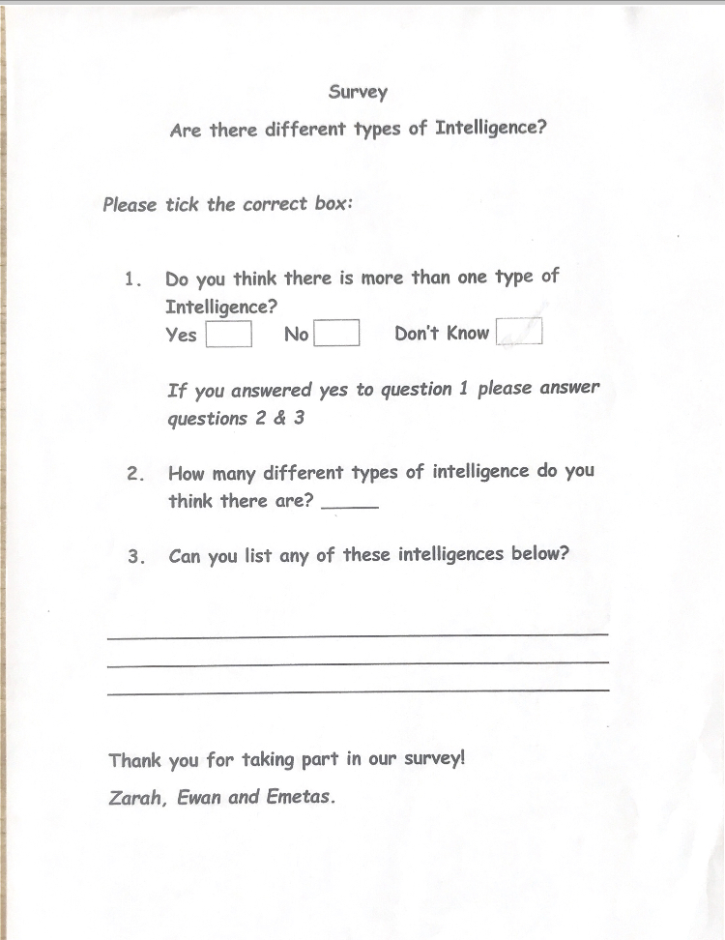
Here is a sample of our survey

Slide 5
Do You Think There is More Than one Type of Intelligence?
We surveyed 98 people for this project.

Slide 6
What types of intelligence did people list in the survey?
LINGUSTIC
GAMING
SPORT
DRIVING
EMOTIONAL
NATURE
MATH
READING
COOKING/BAKING
MUSICAL
SCIENCES
INTRAPERSONAL

Slide 7
What do we understand by the term intelligence?
The dictionary describes intelligence as “the ability to acquire knowledge and skills”

Slide 8
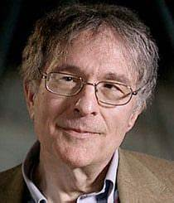
So , are there multiple types of intelligence?
Howard gardner, a developmental psychologist, from Harvard university came up with the theory of multiple intelligence. He stated that there were many more intelligences than just the ‘G’ intelligence ; the general intelligence.
He believes that we are not born with all of our intelligence that we will have
He believes also that there may be more than the 8 types he talks about but believes those eight to be the main types of intelligence.
He is part of the ‘project zero’ research which tries to understand and nuture humans including looking at their intelligence.

Slide 9
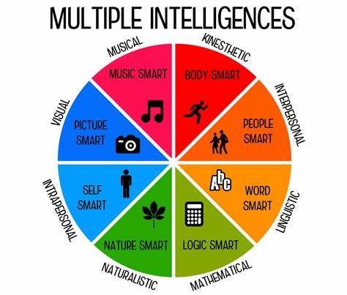
Multiple Intelligence Wheel Gardener represents these intelligences on a wheel.

Slide 10
List of intelligences from wheel
Musical - Music Smart
Kinesthetic – body smart
Interpersonal – people smart
Lingustic – word smart
Mathematical – logic smart
Naturalistic – nature smart
Intrapersonal – self smart
Spatial/Visual – seeing the world in 3-D

Slide 11
Does everyone agree with this theory?
While many people agree with the idea of multiple intelligences (and some believe in even more than the 8 listed by Gardner) there are some people that think these are not intelligences but rather talents or gifts.

Slide 12
REsults
The results of the survey showed us that people are not too sure if there are multiple intelligences but almost half of the people surveyed thought there were.
51% 0f the people who believed in multiple intelligences believed there were more than 10.
After researching Gardner’s theory we see that it is widely believed that there are many intelligences.

Slide 13
conclusion
We believe that there are many different types of intelligence but we think that there needs to be more research and field studies to find out exactly how many.
By understanding that there are different intelligences each person can be supported to learn to the best of their ability and achieve what they wish.

Slide 14
Thank you for watching our presentation dr. Davide tiana

